Slide 1


AI Visionaries_040
🍁
State/UT wise Sexual Assault Data Analysis (India)

Slide 2

IA Manager - Ritik
…Members…
Prites Bera . ft38_518
Shivam Mahajan . ft38_204
3. Malhar Dighe. ft37_596
4. Nisha Rana . ft38_222
5. Paleti Saiteja . ft38_206

Slide 3

★ Purpose of Our Research
We analyze State/UT-wise Sexual Assault Cases
across India from 2001 to 2014, focusing on highly
sensitive regions and critical years where significant
changes were observed.
Through comprehensive data visualization, we
uncover patterns and trends across various
categories of assault, providing in-depth insights
into both the nature and timing of these cases.
Our goal is to highlight the most affected regions,
identify key timeframes, and support future preventive
efforts by offering a clearer understanding
of the dynamics involved.

Slide 4


★ Introduction :
Context of the Study
Examination of crimes against women in India, focusing on rape cases.
Importance of Data Analysis
Understanding trends and patterns in gender-based violence.
Informing policy decisions and resource allocation for prevention.
Dataset Overview
Source: https://www.kaggle.com/datasets/greeshmagirish/crime-against-women-20012014-india
Covers multiple states and union territories across several years.
Includes various types of crimes against women for comprehensive analysis.
Key Objectives
To identify geographical and temporal trends in rape cases.
To compare rape incidents with other crimes against women.
To highlight districts and states with significant concerns.
Expected Outcomes
Insights to support advocacy for women's safety and legal reforms.
Recommendations for community awareness and intervention strategies.

Slide 5
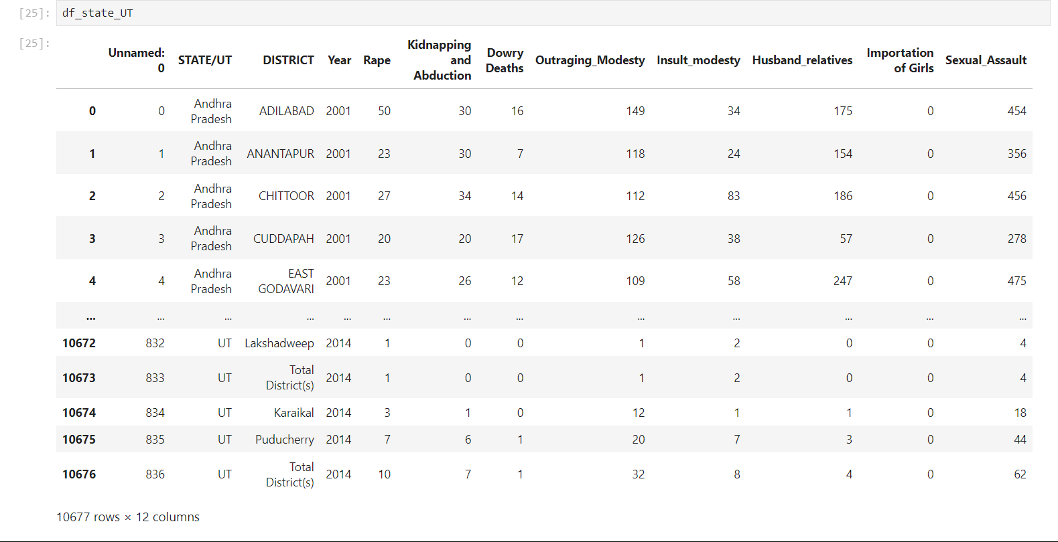
★ Dataset Description :
Structure
Multiple columns related to crimes against women.
Key Columns:
Unnamed: 0: Index reference.
STATE/UT: State or union territory.
DISTRICT: Location of incidents.
Year: Year of data collection.
Crime Categories:
Rape: Total reported cases.
Kidnapping and Abduction: Cases of kidnapping.
Dowry Deaths: Deaths related to dowry disputes.
Outraging Modesty: Incidents compromising dignity.
Insult Modesty: Derogatory actions or remarks.
Husband Relatives: Crimes by in-laws.
Importation of Girls: Trafficking-related cases.
Time Frame:
Data spans from 2001 to 2014
Significance:
Analyzes prevalence of crimes against women.
Identifies patterns for targeted interventions.

Slide 6

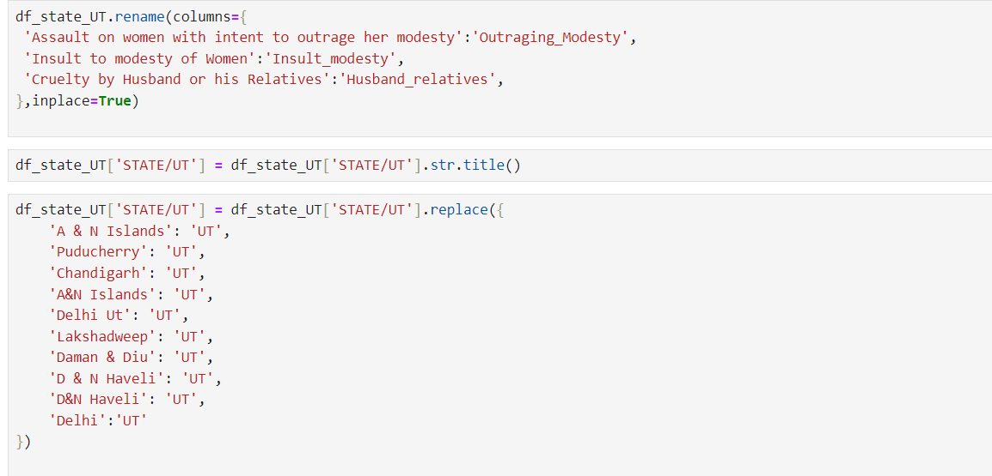
★DATA Cleaning :
Steps Taken:
Removed duplicates.
Handled missing values.
Standardized column names.
Renamed columns for clarity.
Converted data types
(e.g., object values as
float or integer values).
Outcome:
Ensured data consistency and accuracy for analysis.

Slide 7
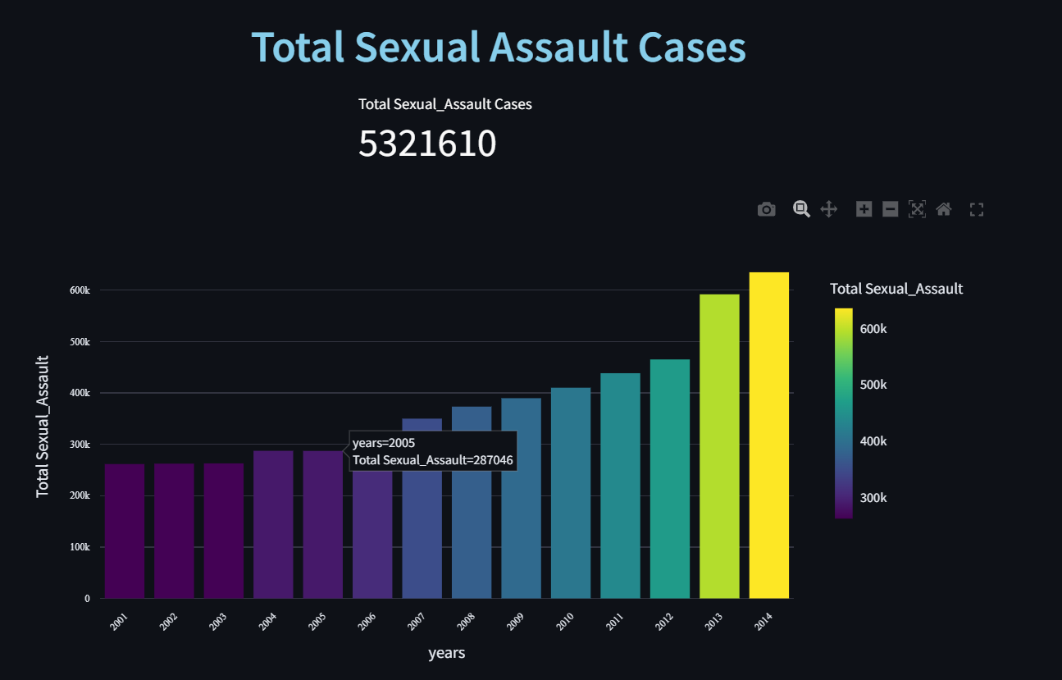
★Exploratory Data Analysis (EDA)
EDA is an iterative process to explore
and understand data. It involves:
Summarizing data using statistics.
Identifying patterns and trends
through visualizations.
Detecting outliers for further analysis.
EDA helps us make informed decisions
and gain insights from data.

Slide 8
★ Trend Visualization :
Time-Series Representation: Line charts are ideal for displaying trends over time, allowing clear visualization of changes in data across specific intervals, such as yearly or monthly data.
Trend Identification: Line charts help easily identify patterns, such as upward or downward trends, seasonality, and cyclical movements, by connecting data points across time periods.
Multiple Series Comparison: Line charts can plot multiple lines to compare different categories or data sets over the same time period, making it easy to see relationships between variables.
Data Smoothing: Line charts often use techniques like moving averages to smooth out fluctuations and highlight long-term trends, reducing the noise in volatile data.
Visual Clarity: By focusing on the relationship between time (x-axis) and the variable of interest (y-axis), line charts offer a simple, clear visual representation of trends, helping in better decision-making.

Slide 9
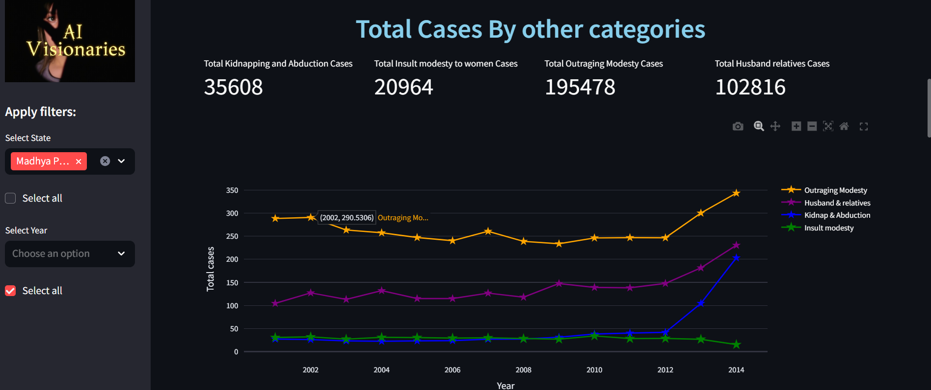
★Trend Visualization : Line Chart

Slide 10
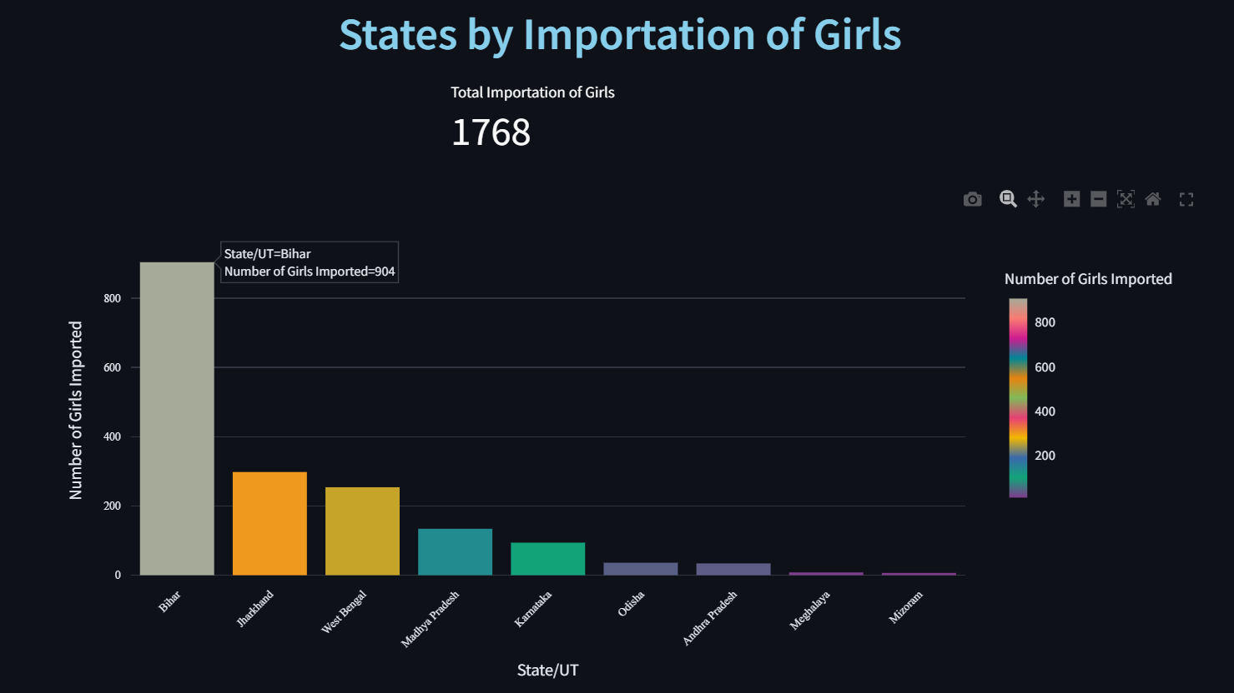
★ Analyze Using Bar Plot :
Bar plots are great for comparing categories.
The height of each bar shows its value or count.
Grouped bars compare variables side-by-side, while stacked bars show the total and easily spot outliers and customize the look of bar plots.

Slide 11
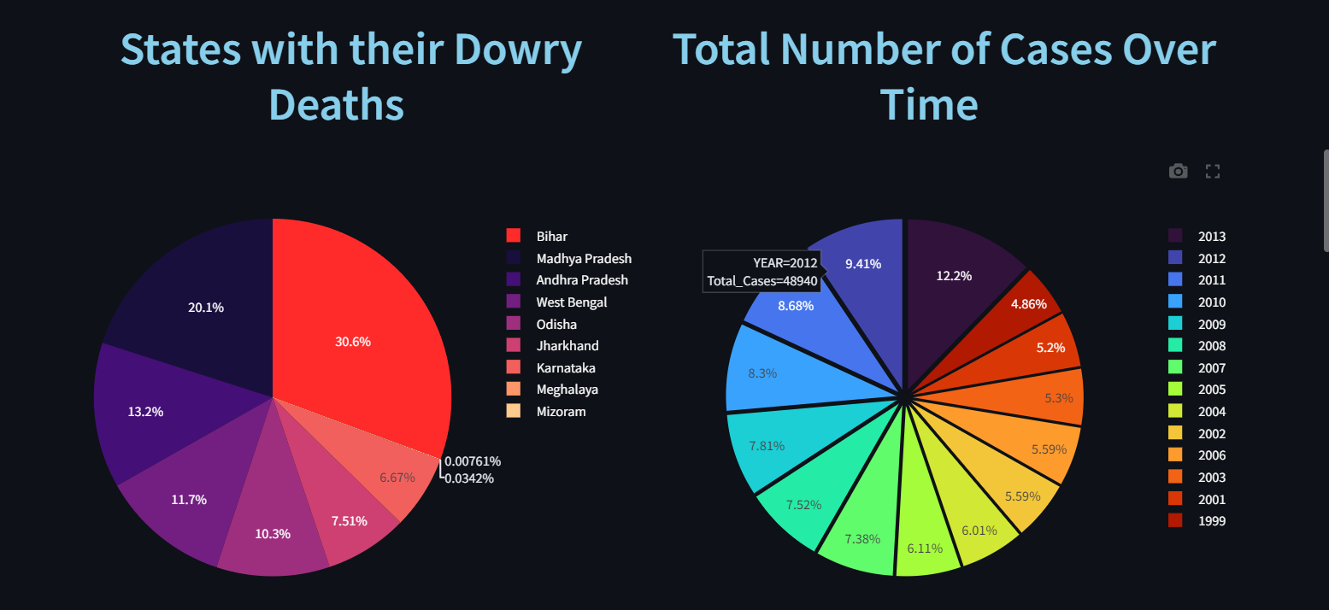
★ visualizing data using pie plot :
Proportional Representation: Show parts of a whole.
Category Segmentation: Each slice represents a category.
Limited Categories: Best for 3-7 categories.
Visual Appeal: Intuitive but limited for precision.
Best for Percentage Breakdown: Market share, survey responses, etc.

Slide 12

★ Conclusion :
Key Findings:
Identified trends in crimes against women.
Highlighted regions with significant concerns.
Noted correlations between crime types.
Implications:
Informed policy recommendations.
Emphasized the need for targeted interventions.
Future Work:
Suggest further research and data collection for deeper insights.

Slide 13
THANK –YOU
…

